Slide 1
Wild Mushroom Identification
Presenters’ name: Xiang Yang, Shikuan Gao, Haoran Du, Ruiwen Shi
Instructor: Yifan Hu

Slide 2
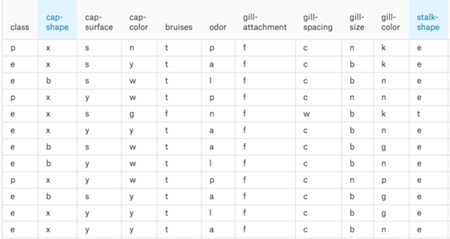
Data Description
Raw data from Kaggle
Dataset with 23 species of gilled mushrooms
Over 8000 variables and 23 attributes
Each attribute influences on the outcome of a single type of mushroom is edible or poisonous

Slide 3
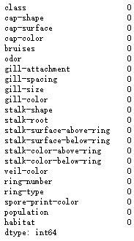
Null Check
Dataset should have no null values
A null indicates that a variable doesn’t point to any object and holds no value
Null values of each attributes is zero

Slide 4
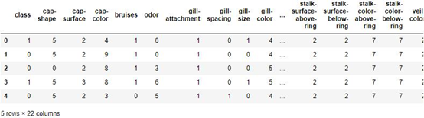
Encoding
Since dataset has string values, it needed to convert all the unique values into integers
Each attribute has a sequence of numbers into a specialized format for efficient analyze in the future process of the project

Slide 5
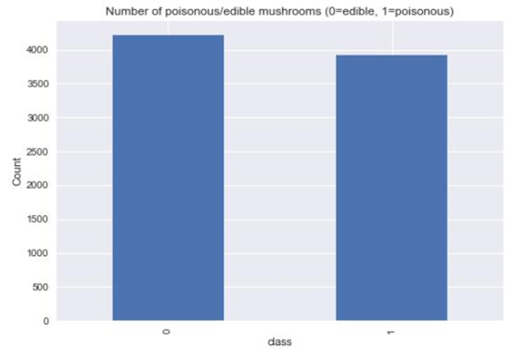
Balance Check
Make sure data prediction will be unbiased towards to the frequent class
Imbalance dataset is a special case for classification problem where the class distribution is not uniform among the classes
Our dataset is basically balance between edible and poisonous

Slide 6
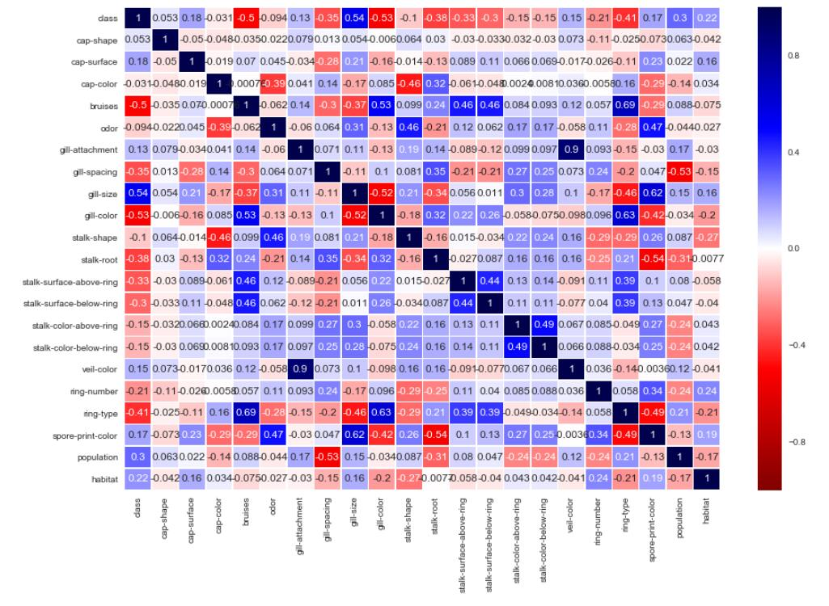
Data Splitting
Split the data into train data and test data according to the ratio of 8 to 2 to build and test the model
Plot correlation matrix
Blue/red blocks mean positive/negative correlation between two attributes
The darker color means stronger correlation

